Slide 1

Title: User Analytics in the Telecommunication Industry
Situational Overview
By:- KALAVATHI ALEGAPALLI
Date:21-04-2025

Slide 2
Abstract:
Title: “Unlocking Growth Opportunities in Telecommunication: A Data-Driven Approach”
In the dynamic telecommunication industry, data-driven insights play a pivotal role in strategic decision-making. As a seasoned analyst, your task is to evaluate TellCo, an existing mobile service provider in the Republic of Pefkakia, and determine its potential for growth.
Abstract: TellCo, a system-generated data-rich telecom company, presents a unique investment opportunity. Leveraging historical customer data, we delve into usage patterns, demographics, and service preferences. Our analysis reveals key insights:
Objectives:
The objective of this analysis is to comprehensively understand and enhance user experiences and satisfaction in the telecom sector through detailed exploratory data analysis (EDA), user engagement metrics, and user experience evaluations.
Task 1: User Overview Analysis focuses on profiling customers by identifying the most popular handsets and manufacturers. Key insights are derived from usage patterns of various applications, covering session counts, durations, data consumption, and volume metrics, while addressing data gaps and outliers.
Task 2: User Engagement Analysis assesses customer engagement by evaluating session frequencies, durations, and total data traffic. Users are segmented into engagement clusters using normalized metrics and k-means clustering, with further insights into top users per application and optimized cluster values derived through the elbow method.

Slide 3
Objectives:
Task 3: User Experience Analytics evaluates network performance and handset characteristics. Aggregated metrics include TCP retransmission, RTT, and throughput, informing clustering analyses that segment users based on experience levels.
Task 4: Satisfaction Analysis integrates engagement and experience scores to predict user satisfaction through regression modeling, clustering, and final score aggregation, culminating in the export of comprehensive user data to a MySQL database and deployment tracking of predictive models.
This analysis enables targeted marketing, resource optimization, and enhancement of user satisfaction in telecom services, driving strategic decision-making for improved customer experiences and operational efficiencies.
Methods:
User Overview Analysis
Top 10 Handsets Used by Customers:
Visual representation of the most popular devices.
Top 3 Handset Manufacturers and Top 5 Handsets per Manufacturer:
Charts showcasing leading manufacturers and their top models.

Slide 4
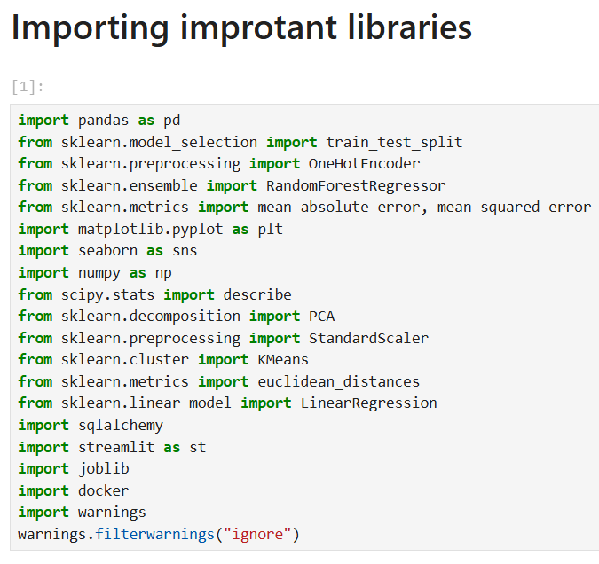
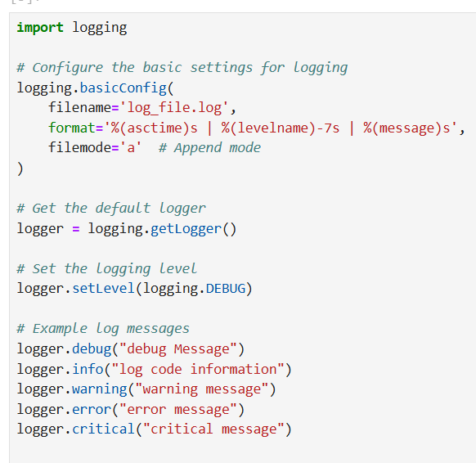
Logger File: Importing libraries:

Slide 5
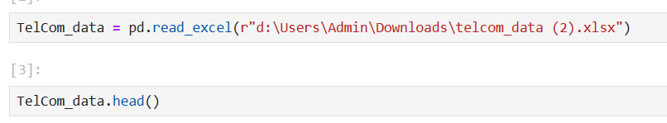
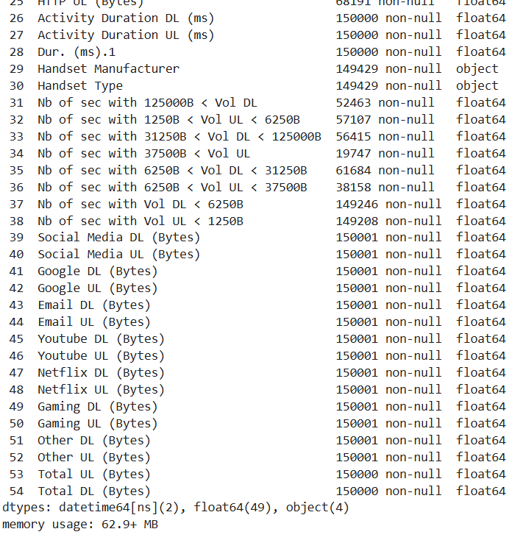
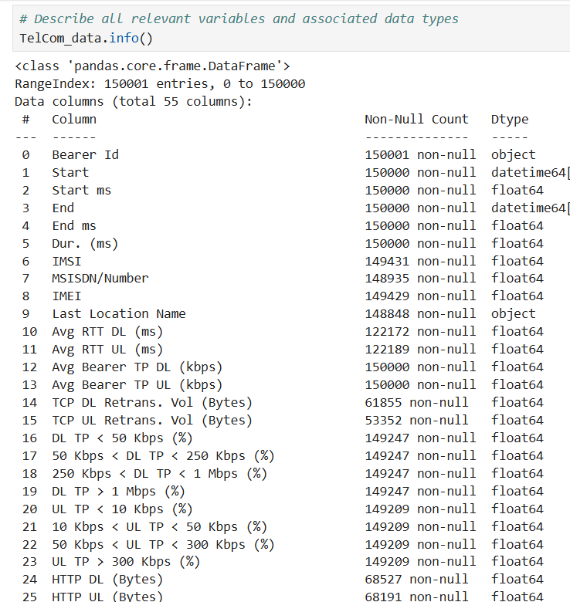
Loading TeleCom Dataset

Slide 6
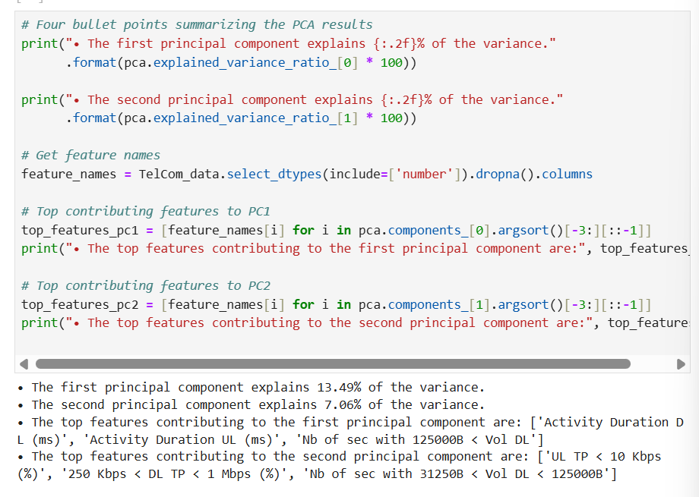
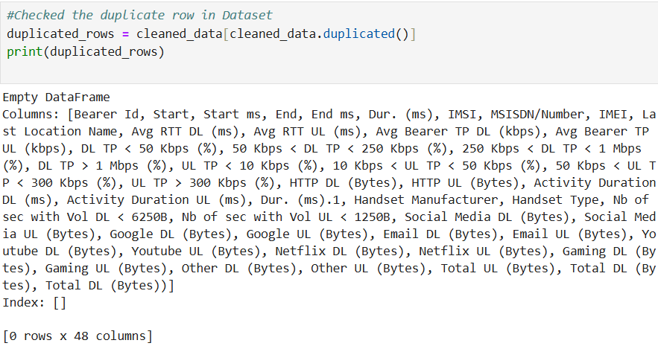
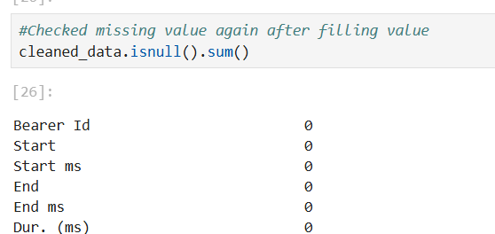
PCA Results:
Handled
Outliers
Missing values
Duplicate values

Slide 7
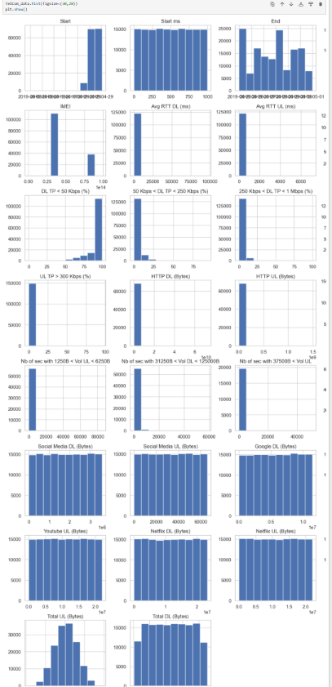
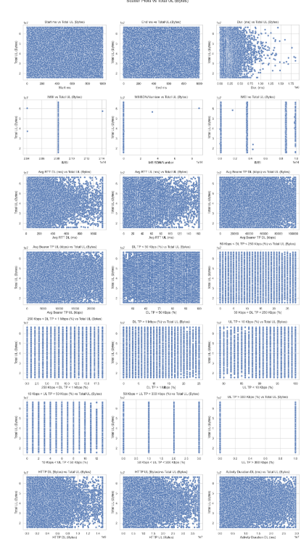
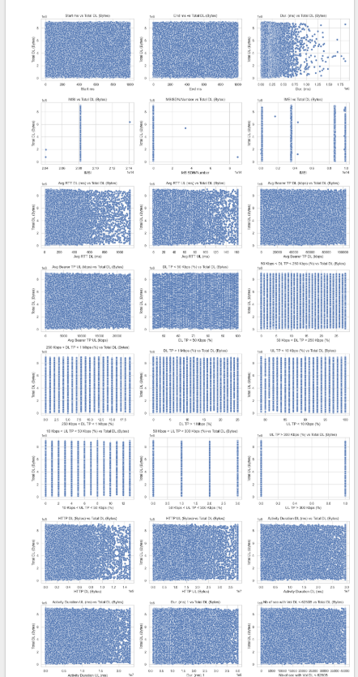
Univariant analysis: Bivariant analysis with respect to 'Total UL (Bytes)', 'Total DL (Bytes)
1. Univariate Analysis: Focuses on individual variables, with histograms displaying their distribution, central tendency, and spread.
2. Bivariate Analysis: Examines relationships between two variables using scatter plots, revealing correlations and patterns, like the connection between `Total UL (Bytes)` and `Total DL (Bytes)`.

Slide 8
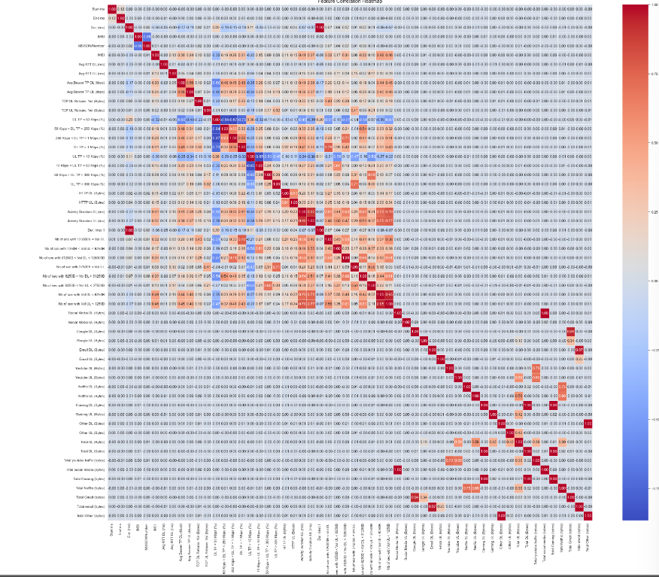
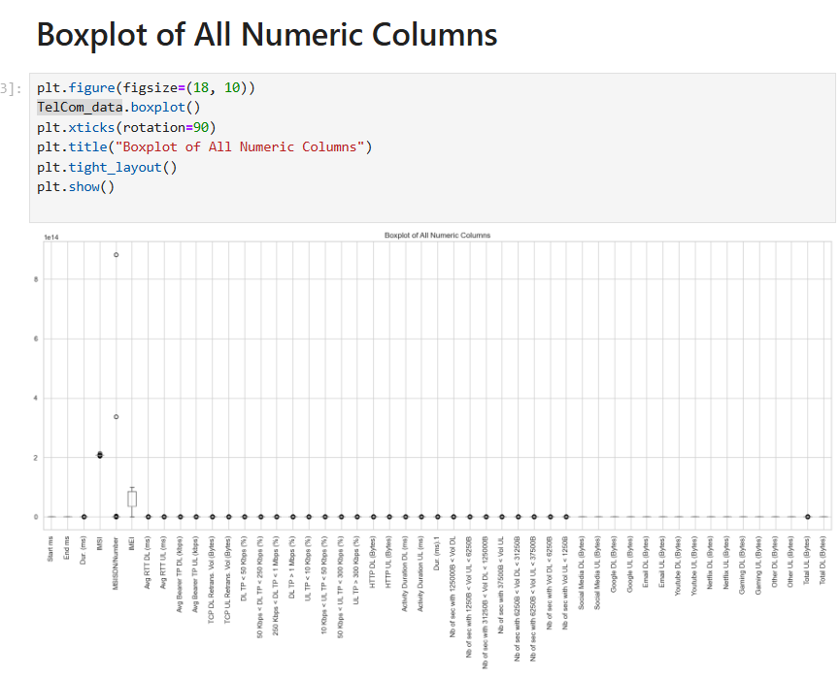
Correlation Heatmap: Boxplot
1. **Correlation Heatmap**:
- Visualizes the strength and direction of correlations between variables.
- Uses a color gradient: red for strong positive correlations and blue for strong negative correlations.
- Helps identify relationships within the dataset.
2. **Boxplot Summary**:
- Displays the distribution of numeric data, showcasing the median, quartiles, and outliers.
- Helps to understand data spread, central tendency, and detect anomalies.

Slide 9
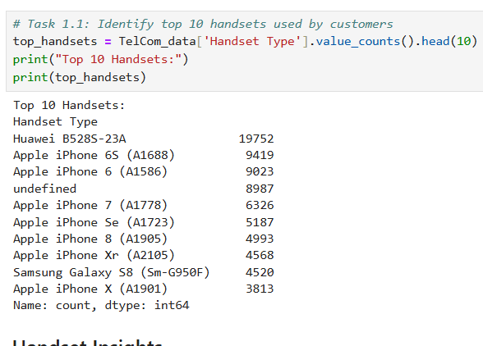
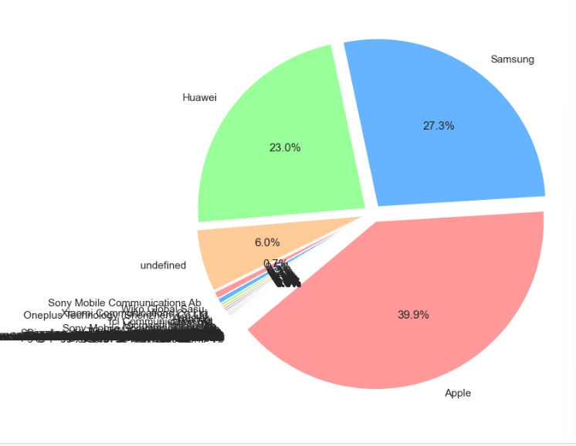
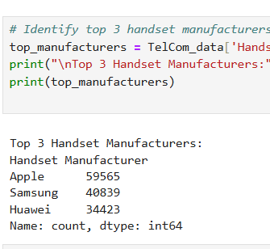
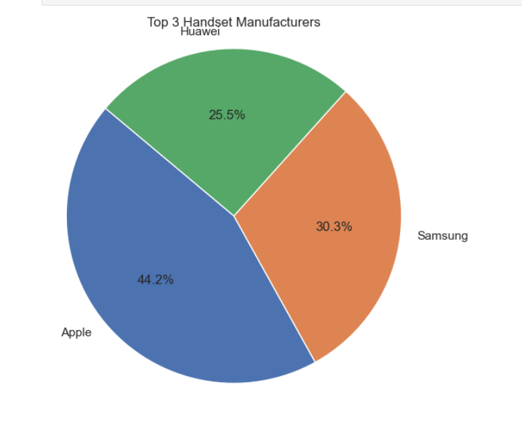

Slide 10
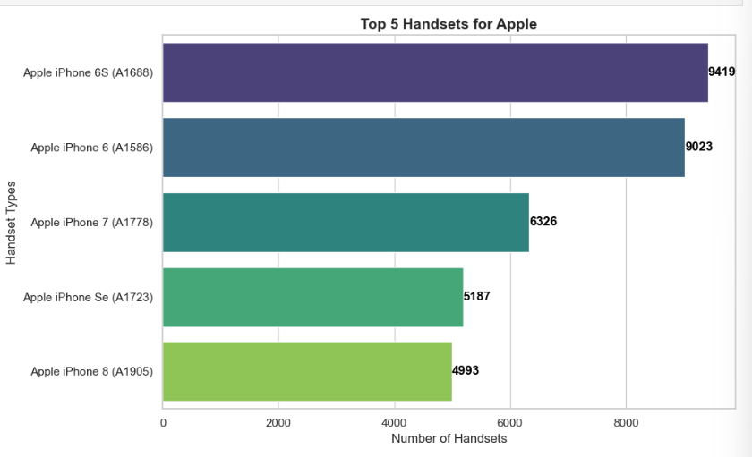
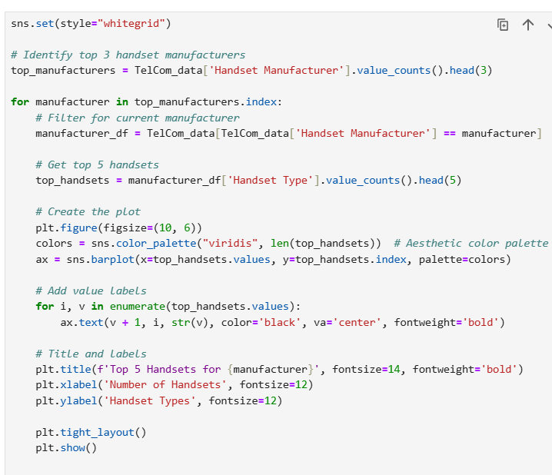
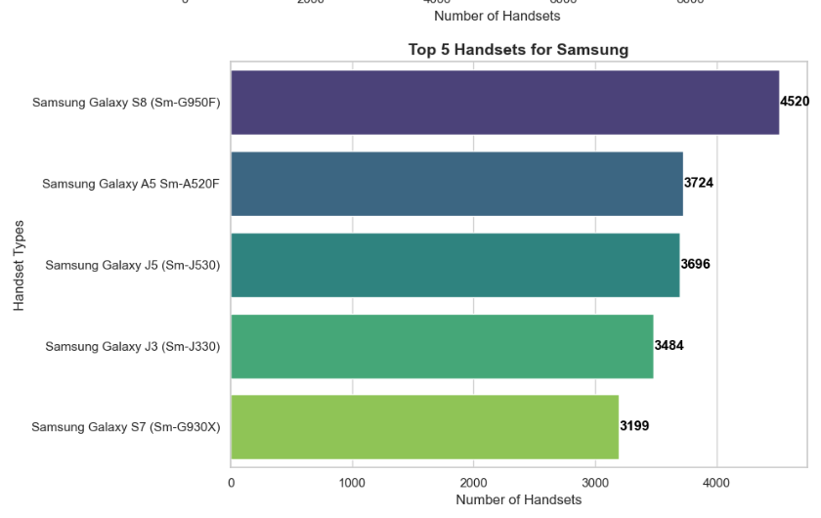
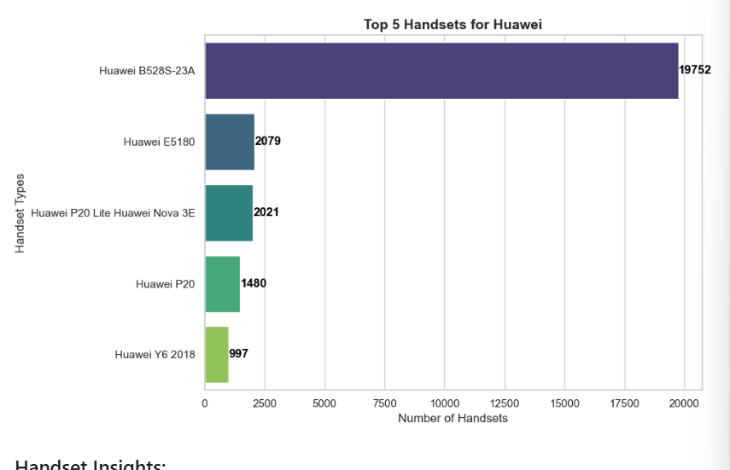
'Top 5 Handsets for manufacturers:
1. Top Handsets Visualization:Bar charts display the top 5 handset models for Apple, Samsung, and Huawei, helping to compare their sales performance visually.
2. Data Analysis through Code: Python code filters data for top manufacturers and handsets, generating insightful visualizations with libraries like seaborn and matplotlib.

Slide 11
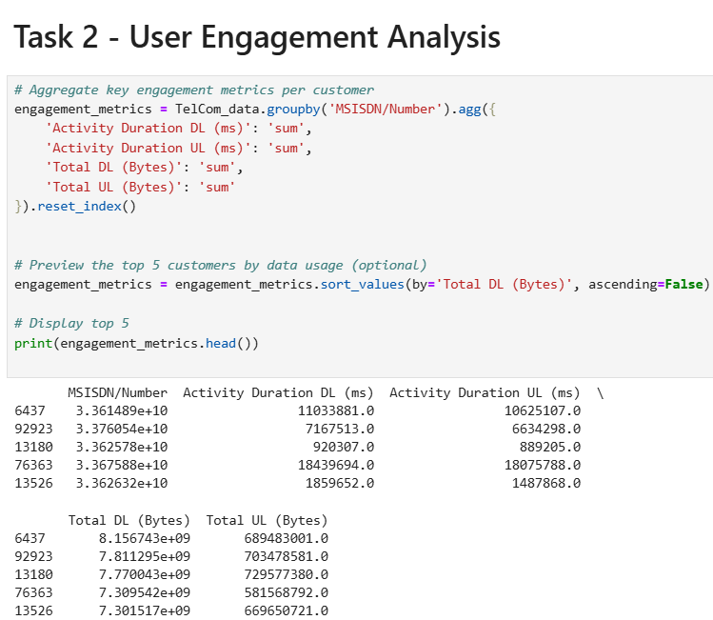
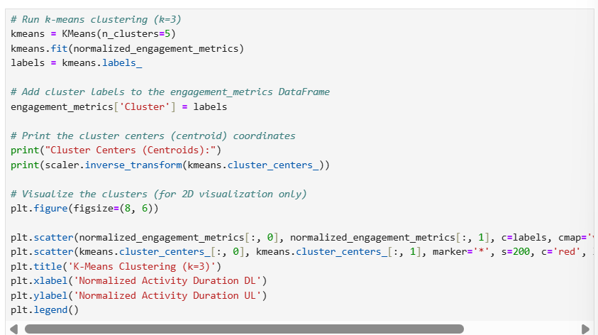
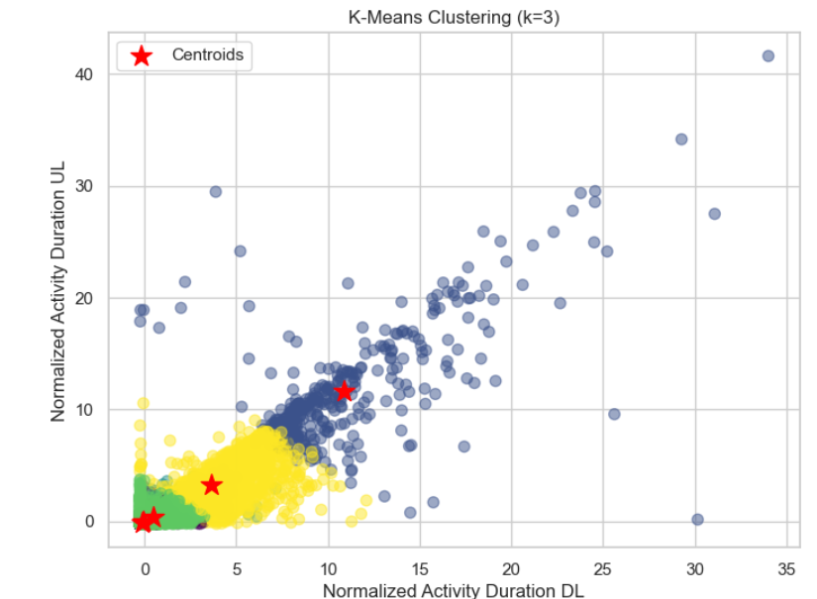
User Engagement Analysis:
User Clustering with K-Means: Customers were clustered into 3 distinct groups based on normalized activity duration (DL/UL) and total upload usage using K-Means clustering for engagement segmentation.
Top 5 Low-Engagement Users Identified: Users with the lowest total upload volume were extracted, indicating potential low engagement or under-utilization of services.

Slide 12
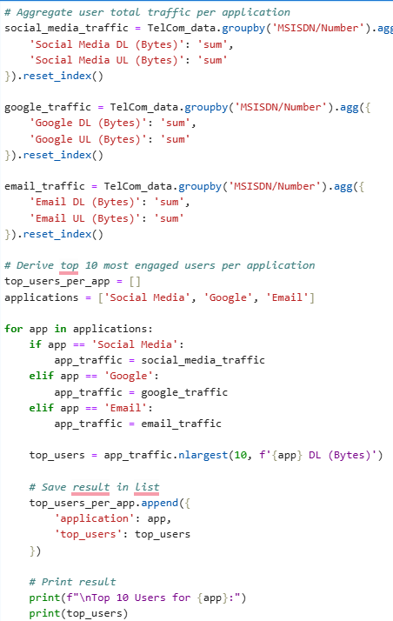
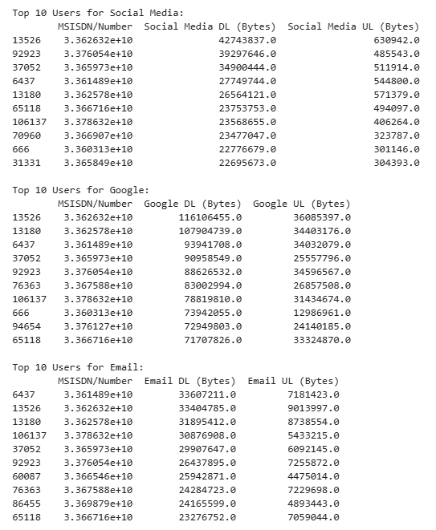
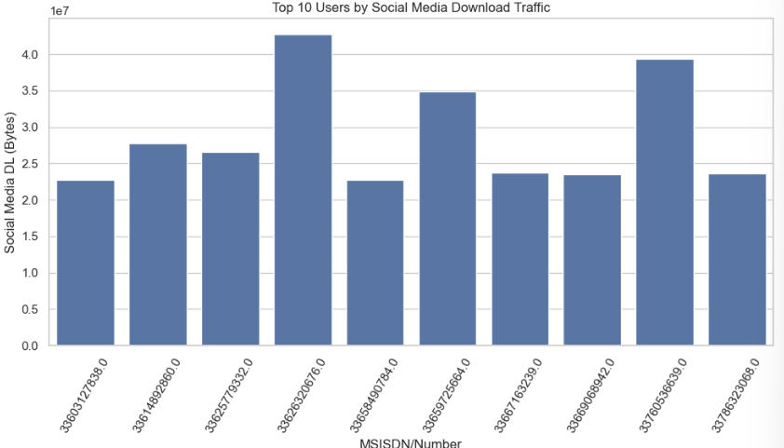
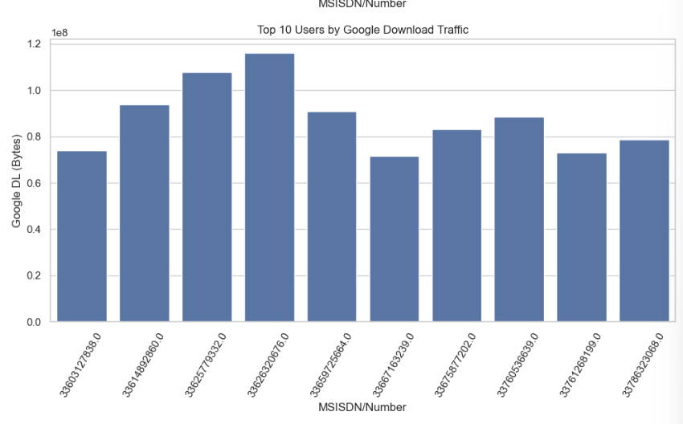
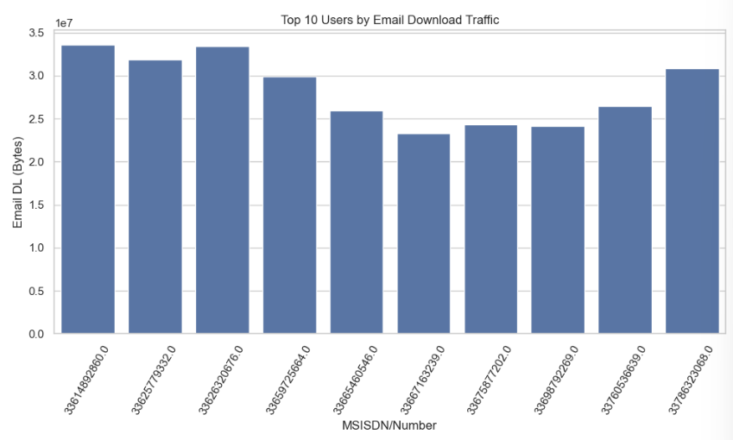
Top 10 Users:

Slide 13
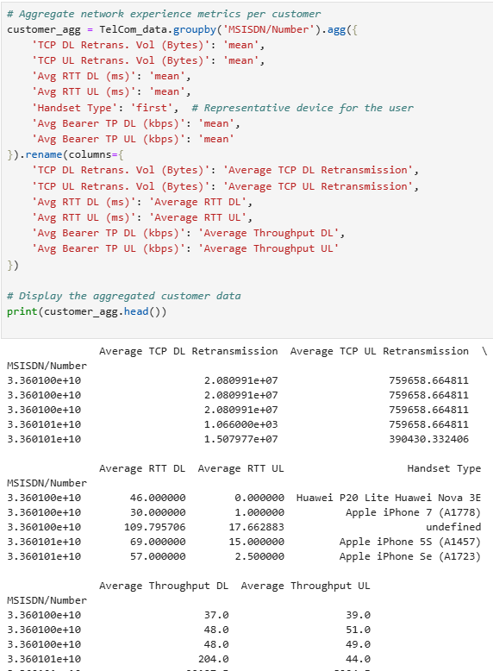
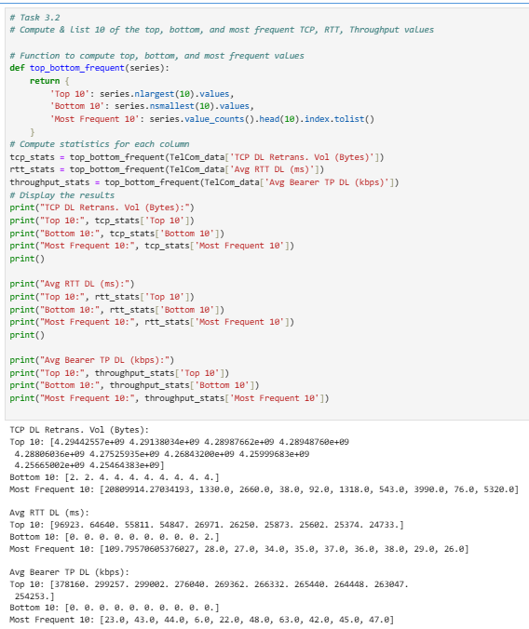
User Experience Analysis:
Aggregated Network Experience Metrics: Key network parameters like TCP retransmissions, RTT, and throughput were averaged per customer and device to assess network quality and performance.
Top, Bottom, and Frequent Value Analysis: Identified users experiencing the highest and lowest network performance along with the most frequent TCP, RTT, and throughput values to highlight service consistency and anomalies.

Slide 14
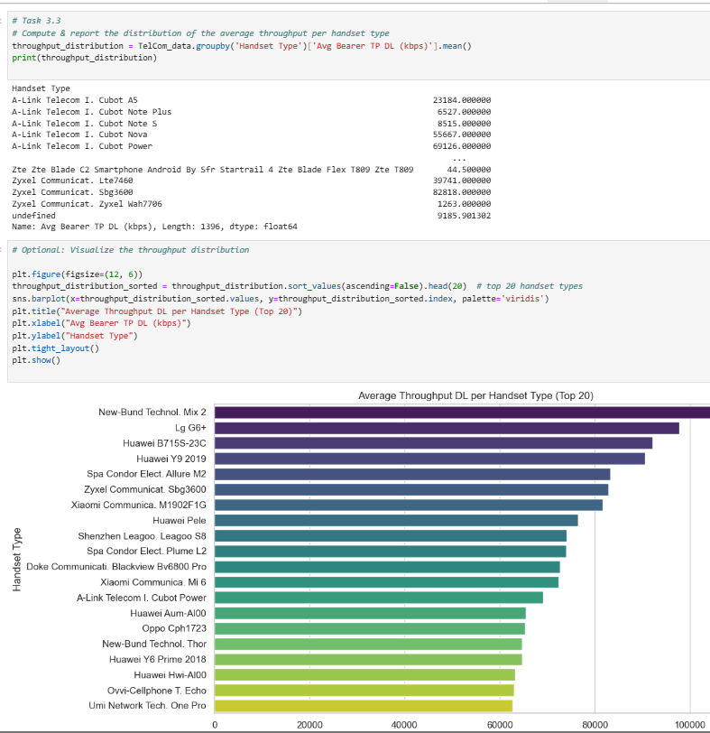
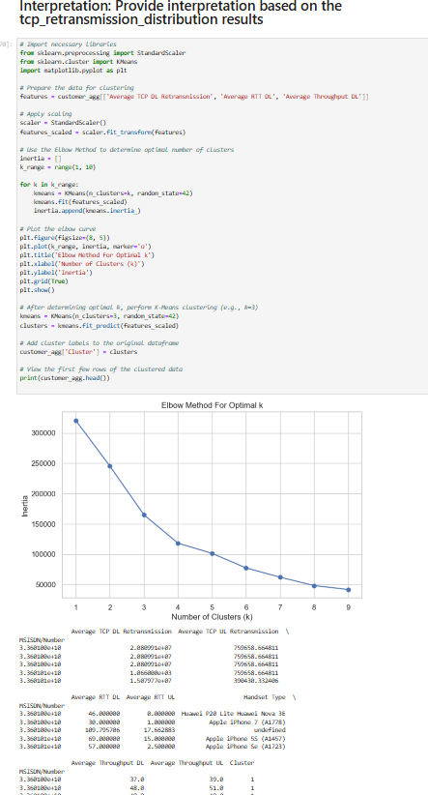
Network Throughput & Device Type Analysis:
Throughput Distribution by Device Type: Devices were ranked based on average DL throughput, revealing that newer models like Huawei SCL-L01 and New Band Sourced Models offer better network performance.
Clustering & Elbow Method: Applied K-means clustering with Elbow Method to identify optimal cluster groups for network experience segmentation based on metrics like RTT, TCP retransmissions, and throughput.

Slide 15
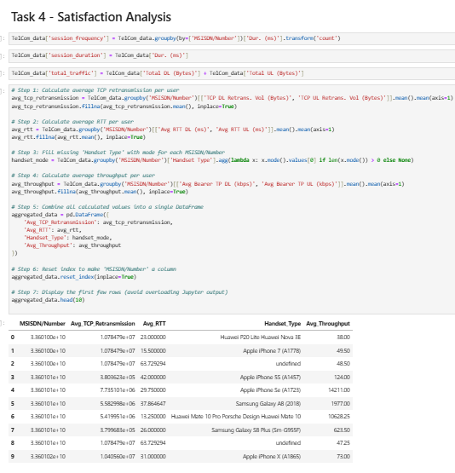
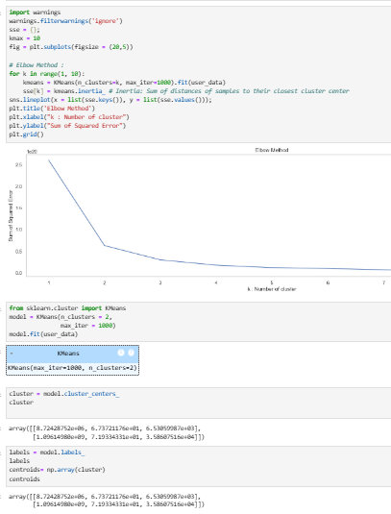
Task 4 – Satisfaction Analysis:
Customer Satisfaction Scoring: Derived satisfaction scores based on normalized values of RTT, TCP retransmission, and throughput; higher throughput and lower delays indicate better satisfaction.
Cluster-Based Segmentation: Used K-means clustering and the Elbow Method to segment users into distinct satisfaction groups, enabling targeted service improvements.

Slide 16
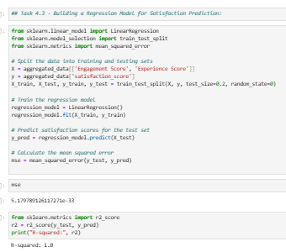
Regression Model for Satisfaction Prediction
Task 4.3 – Regression Model for Satisfaction Prediction
Model Building and Training: A Linear Regression model was developed to predict user satisfaction scores based on Engagement Score and Experience Score. The dataset was split into training and testing sets (80-20 split), and the model was trained on the training data.
Model Evaluation Results: The model achieved a Mean Squared Error (MSE) close to zero and an R² score of 1.0, indicating a perfect fit on the test data. This suggests the selected features (engagement and experience scores) are highly effective in predicting user satisfaction.

Slide 17
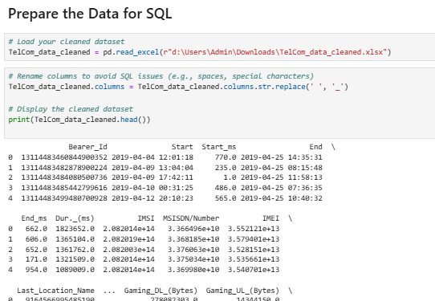
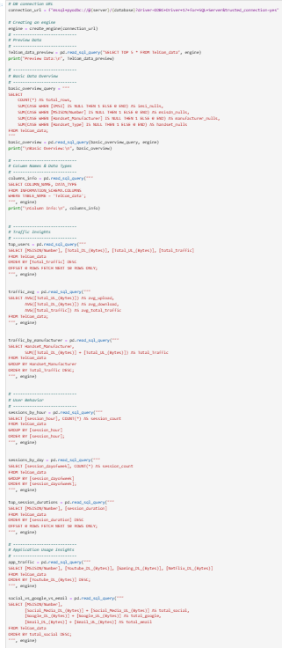
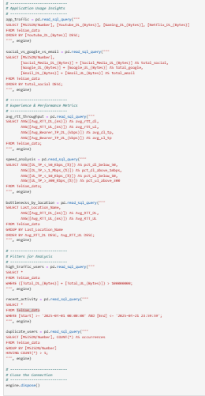
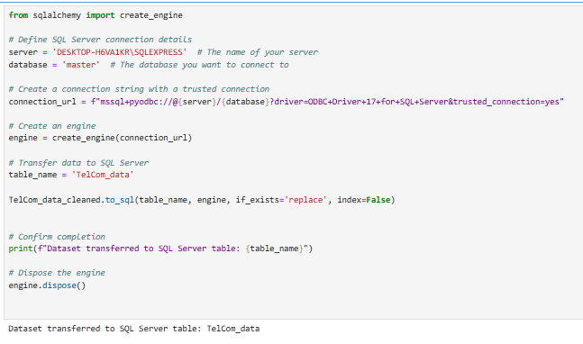
Data Preparation and SQL Integration
Data was preprocessed in Python and successfully transferred to a SQL Server table, followed by the creation of multiple SQL views for efficient querying and analysis.

Slide 18
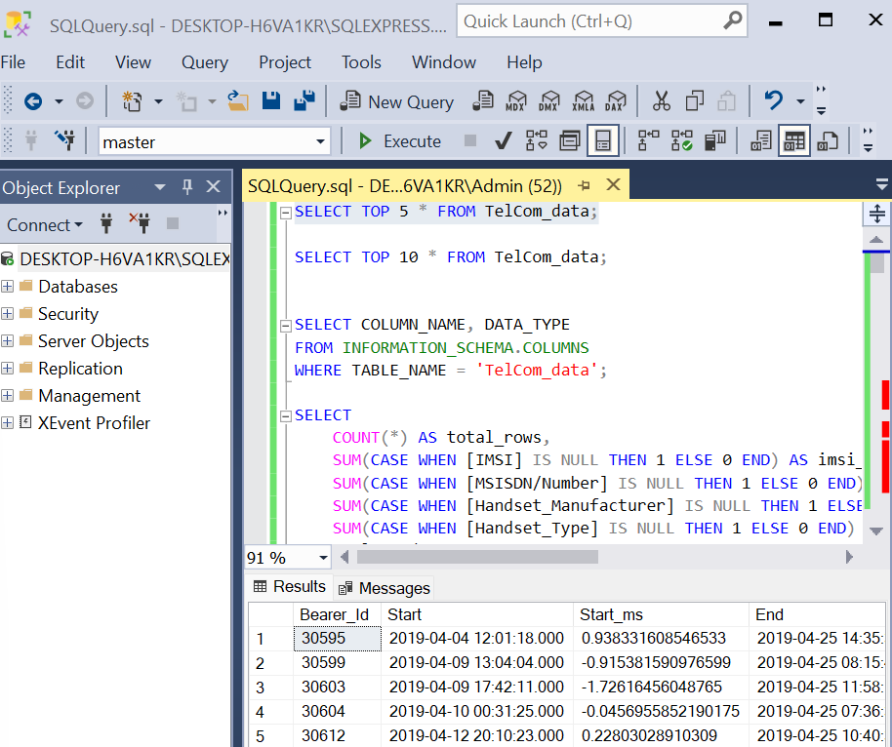
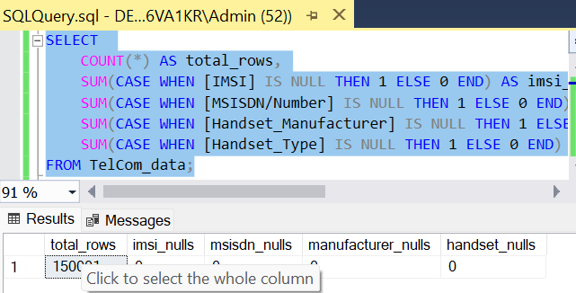
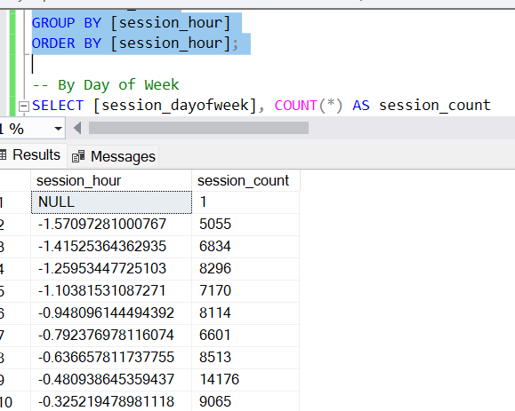
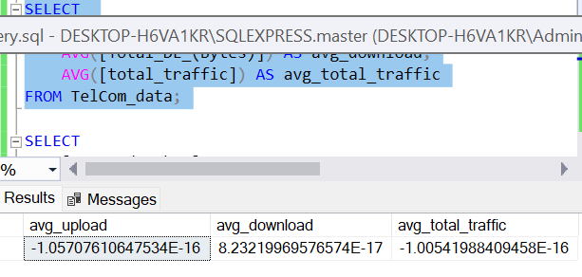
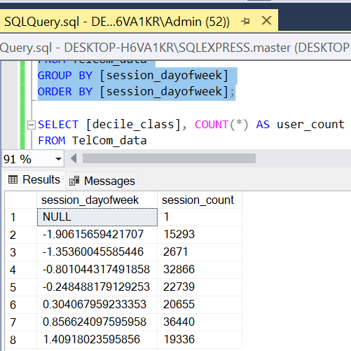
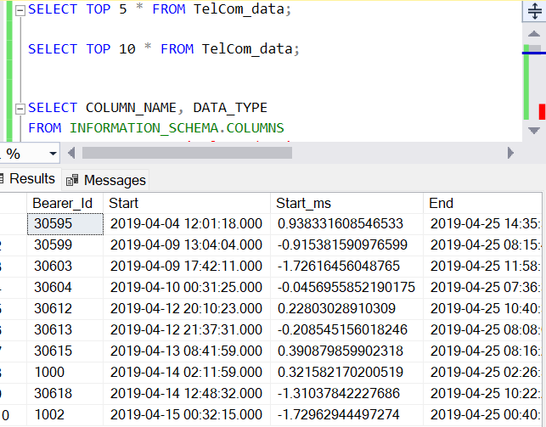
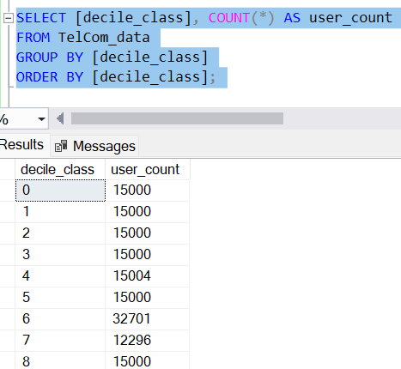
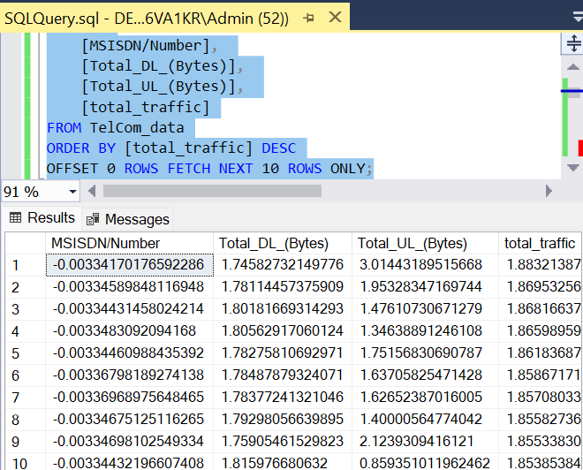
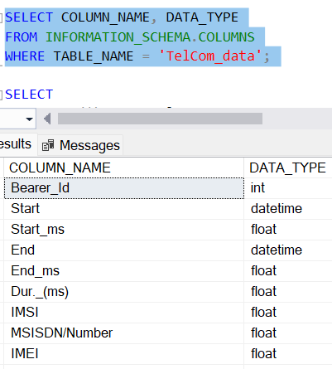

Slide 19
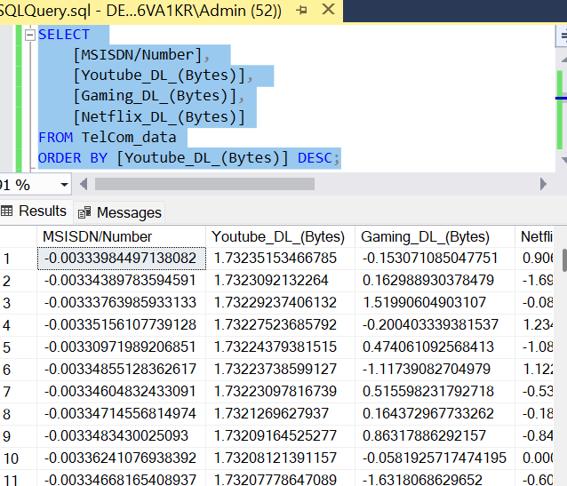

Data Aggregation: SQL queries enable summarizing vast datasets. For instance, calculating totals and averages of key metrics like traffic or identifying the number of missing values in specific fields helps in understanding overall data quality and trends.
2. Data Grouping and Segmentation:By grouping data (e.g., by session hours or user categories like decile classes), the queries reveal patterns or behaviors in subsets of the data, aiding in targeted analysis or decision-making.
3. Insights from Calculations:SQL facilitates deriving insights through operations like averaging upload/download traffic. This highlights key usage metrics and supports identifying abnormal data patterns.
4. Focused Data Filtering: Filtering based on specific conditions (e.g., selecting float-type data fields) extracts relevant subsets, ensuring that only the required data is analyzed further.

Slide 20
Final Conclusion
Summary
TellCo shows strong growth potential, especially in:
Video streaming
Social media usage
Mobile gaming
Key Insights
High user engagement & retention
Performance issues (latency, retransmission) are localized and manageable
Top users contribute significantly to traffic – a revenue opportunity
Limitations
Some missing data (RTT, retransmission)
No direct customer satisfaction feedback
Recommendation Acquire TellCo
Valuable user base + high engagement
Clear potential for data monetization and strategic growth
Targeted infrastructure upgrades can enhance performance & user satisfaction

Slide 21
Thank You!

